Slide 1
Deep face recognition
Omkar M. Parkhi, Andrea Vedaldi, Andrew Zisserman
Parkhi, Omkar M., Andrea Vedaldi, and Andrew Zisserman. "Deep Face Recognition." BMVC. Vol. 1. No. 3. 2015.

Slide 2
Key Questions
Can large scale datasets be built with minimal human intervention?
Can we propose a convolutional neural network which can compete with that of internet giants like Google and Facebook?
Yes!
Yes!

Slide 3
Achievements
New face dataset of 2.6 Million Faces
State of the art results on YouTube faces in the wild dataset
Comparable to the state of the art results on the Labeled faces in the wild dataset

Slide 4
Can large scale datasets be built with minimal human intervention?

Slide 5


Dataset Collection
Candidate list generation: Finding names of celebrities
Tap the knowledge on the web
5000 identities
Robert Downey Jr.
Allison Hannigan
Ashley Hamilton
Amitabh Bacchan
Barack Obama
Vladimir Putin

Slide 6

Dataset Collection
Manual verification of celebrities: Finding Popular Celebrities
Collect representative images for each celebrity
200 images/identity
Remove people with low representation on Google.
Remove overlap with public benchmarks
2622 celebrities for the final dataset
(Why celebrities?)

Slide 7
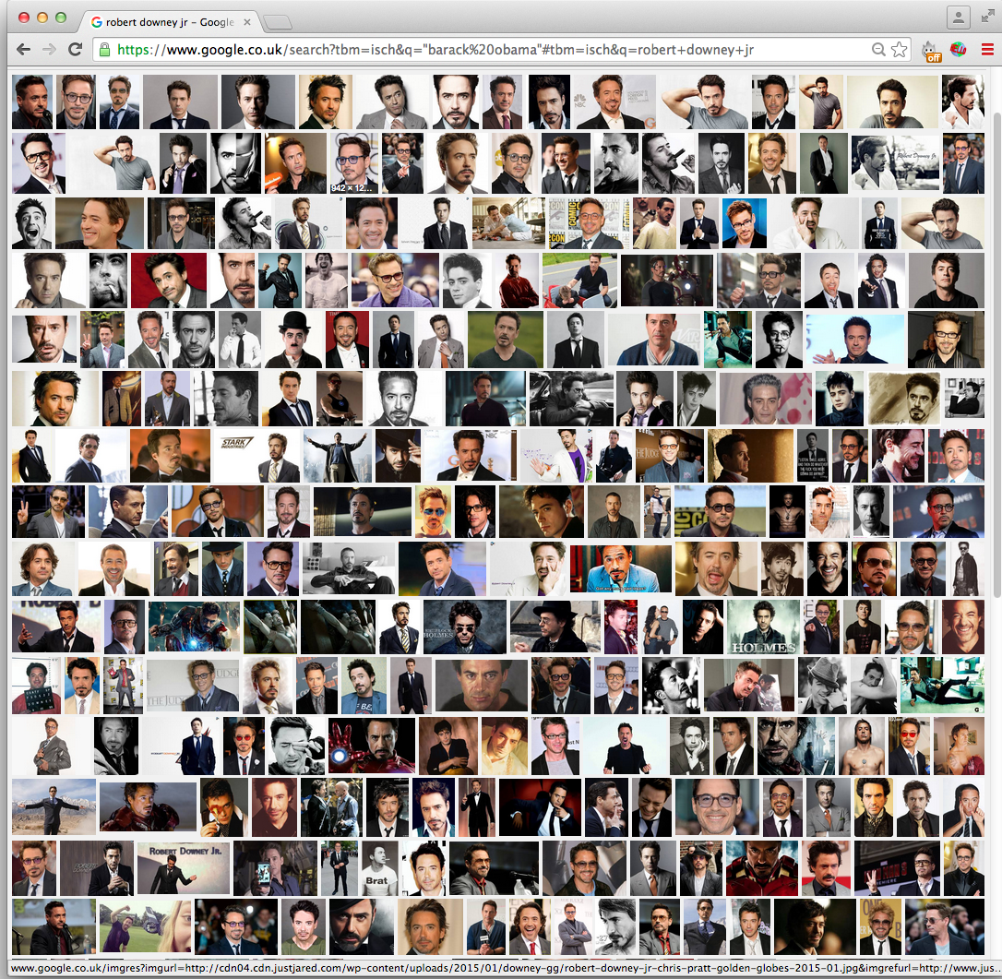
Dataset Collection
Popular Celebrity
Robert Downey Jr.

Slide 8
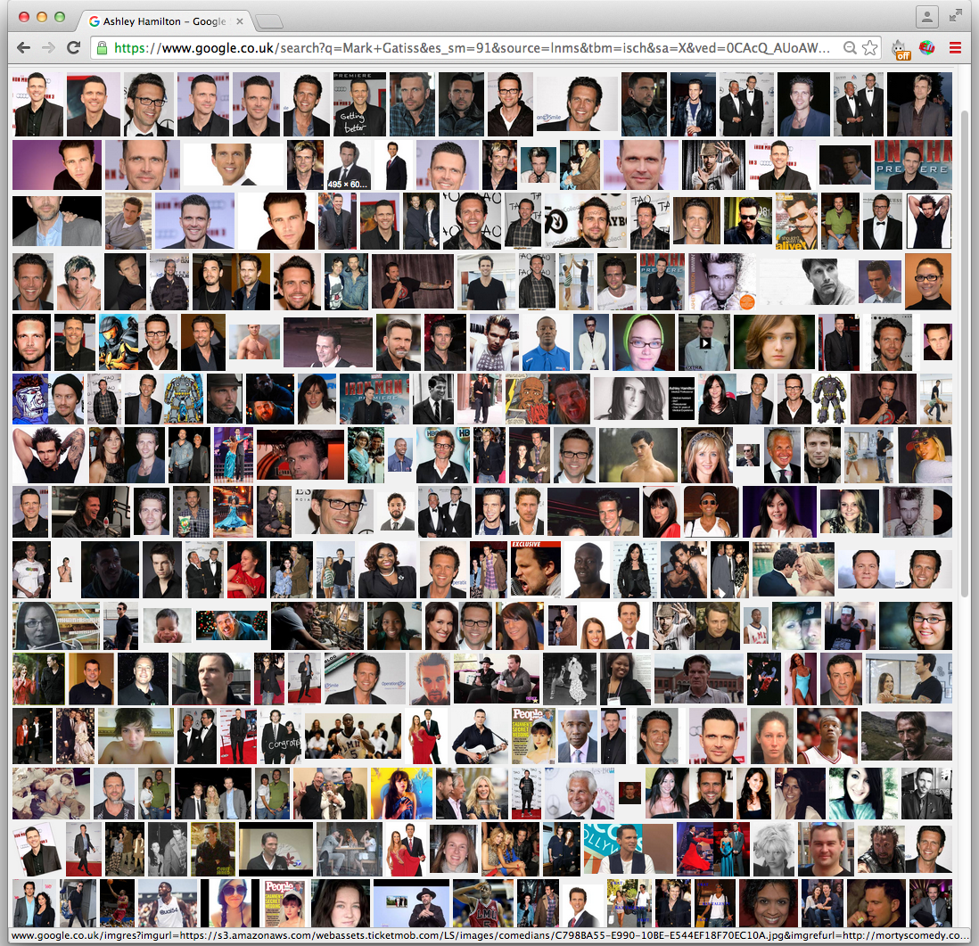
Dataset Collection
Not so popular
celebrity
Ashley Hamilton

Slide 9

Dataset Collection
Rank image sets
2000 images per identity
Searching by appending keyword “actor”
Learning classifier using data obtained the previous step.
Ranking 2000 images and selecting top 1000 images
Approx. 2.6 Million images of 2622 celebrities

Slide 10
Dataset Collection
Near duplicate removal
VLAD descriptor based near duplicate removal
manual filtering
Curating the dataset further using manual checks
No. | Aim | Mode | # Persons | # images /person | Total # images | Anno. effort
1 | Candidate list generation | Auto | 5000 | 200 | 1,000,000 | -
2 | Candidate list filtering | Manual | 2622 | - | - | 4 days
3 | Rank image sets | Auto | 2622 | 1000 | 2,622,000 | -
4 | Near duplicate removal | Auto | 2622 | 623 | 1,635,159 | -
5 | Manual filtering | Manual | 2622 | 375 | 982,803 | 10 days

Slide 11
Dataset Collection
Dataset Comparison
No. | Aim | # Persons | Total # images
1 | Labeled Faces In the Wild | 5,749 | 13,233
2 | WDRef | 2995 | 99,773
3 | Celeb Faces | 10177 | 202,599
4 | Ours | 2622 | 1,635,159
5 | Facebook | 4030 | 4.4M
6 | Google | 8M | 200M

Slide 12
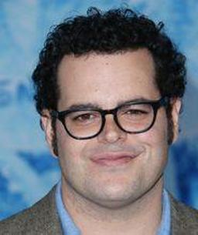
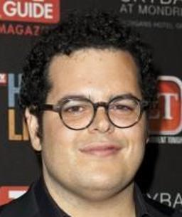


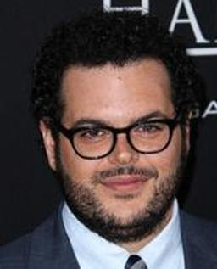
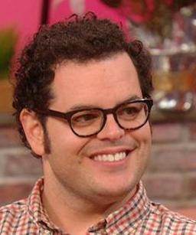
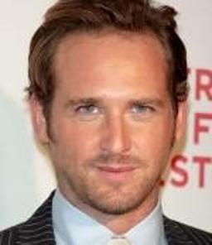

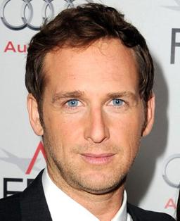

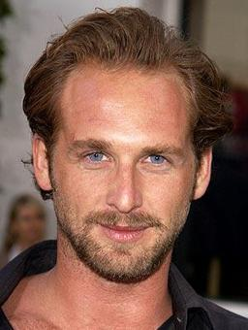
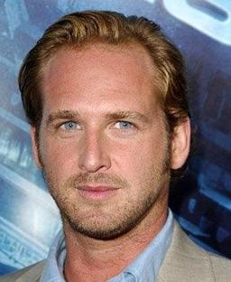
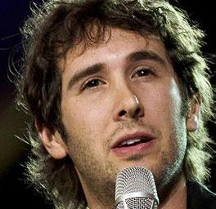
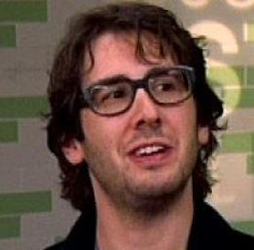
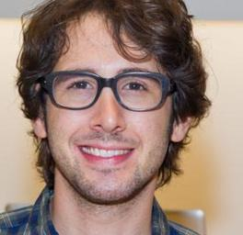

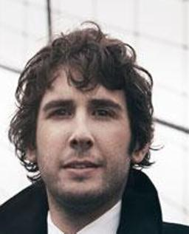
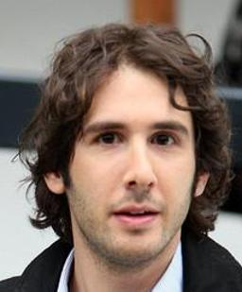







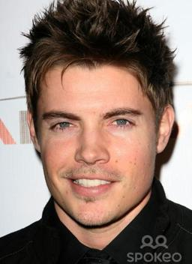
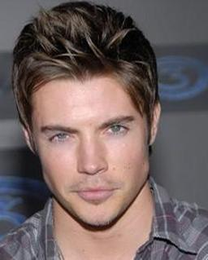

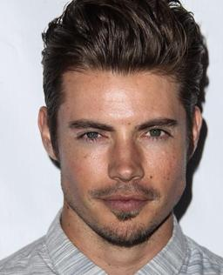
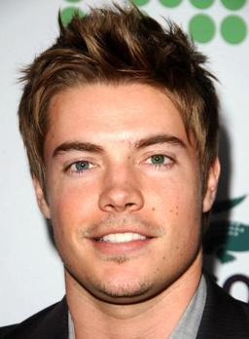

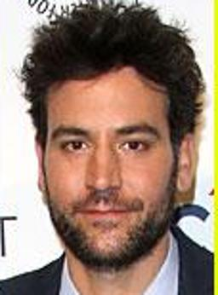

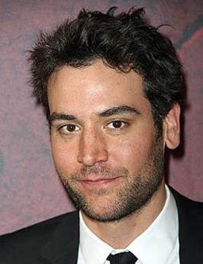
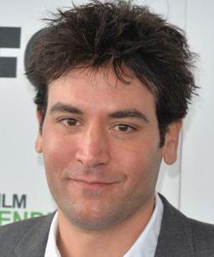

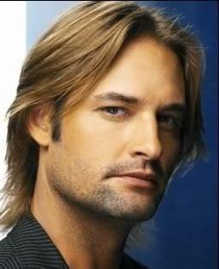

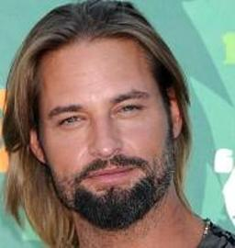
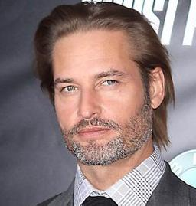







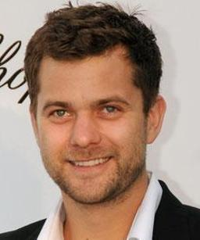
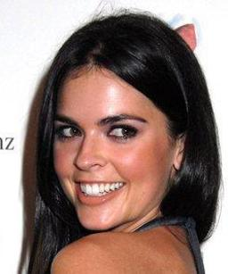
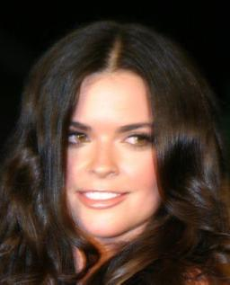
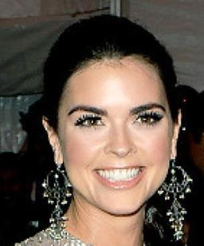
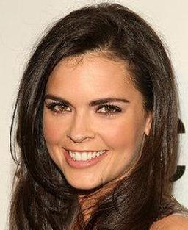
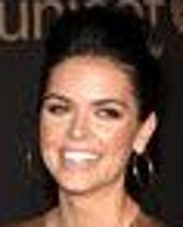
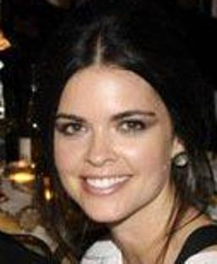

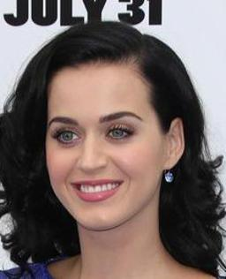
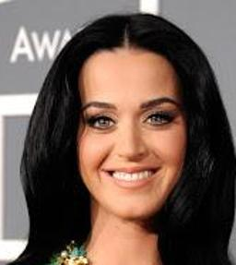
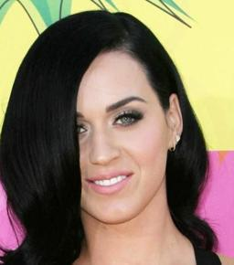
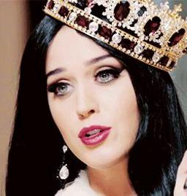
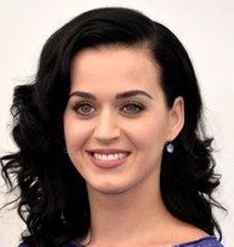
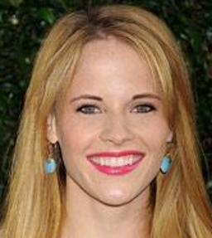
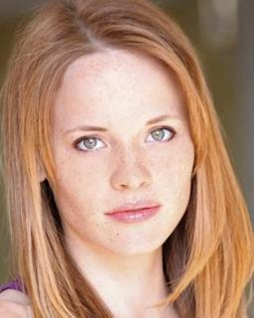
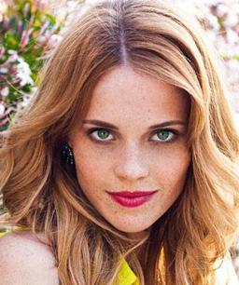
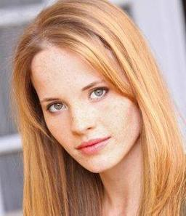
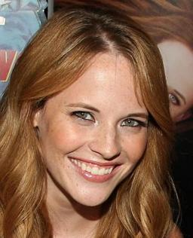
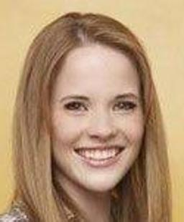
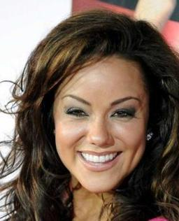
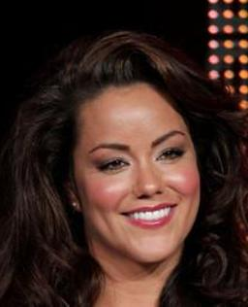
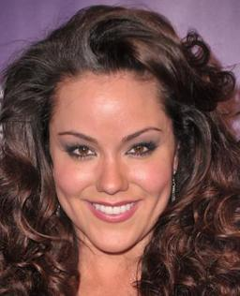

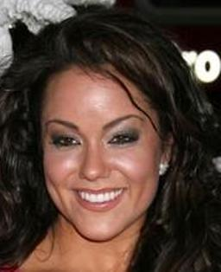
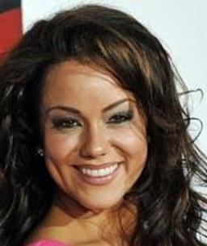
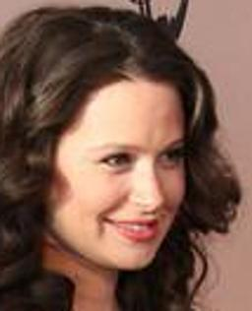
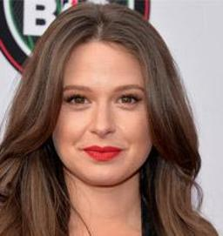










Dataset Collection
Example Images From Our Dataset

Slide 13
Can we propose a convolutional neural network which can compete with that of internet giants like Google and Facebook etc.?

Slide 14
Convolutional Neural Network
image
Conv-64
Conv-64
maxpool
The “Very Deep” Architecture
Different from previous architectures proposed
for face recognition:
locally connected layers (Facebook)
inception (Google)
Network Details:
3 x 3 Convolution Kernels (Very small)
Conv. Stride 1 px.
Relu non-linearity
No local contrast normalisation
3 Fully connected layers
Conv-128
Conv-128
maxpool
Conv-256
Conv-256
maxpool
Conv-512
Conv-512
Conv-512
maxpool
Conv-512
Conv-512
Conv-512
maxpool
fc-4096
fc-4096
fc-2622
Very Deep Convolutional Networks for large-Scale Image Recognition.
K. Simonyan and A. Zisserman.
Softmax

Slide 15
Convolutional Neural Network
image
Conv-64
Conv-64
Training
MatConvNet Tootlbox
Nvidia CuDNN bindings
Multi GPU Training (approx 3.5x speedup)
Nvidia Titan Black
7 days of training
Random Gaussian Initialization
Stochastic Gradient Descent with back prop.
Batch Size: 256
2622 way multi class criterion (soft max)
maxpool
Conv-128
Conv-128
maxpool
Conv-256
Conv-256
maxpool
Conv-512
Conv-512
Conv-512
maxpool
Conv-512
Conv-512
Conv-512
maxpool
fc-4096
fc-4096
Matconvnet – convolutional neural networks for matlab.
A Vedaldi and K. Lenc. Arxiv - 2014.
fc-2622
Softmax

Slide 16
Convolutional Neural Network
Training: Learning Task Specific Embedding
Learning embedding by minimizing triplet loss
Learning a projection from 4096 to 1024 dimensions
On line triplet formation at the beginning of each iteration
Fine tuned on target datasets
Only the projection layers learnt

Slide 17
Design Choices
Network configuration
Does increasing the depth improves performance?
Face alignment
Can the network be invariant to changes in the faces?
Task specific learning
What are the effects of task specific embedding learning on performance?

Slide 18

Labeled Faces In the Wild Dataset (LFW)
Face Verification: Given a pair of images specify
whether they belong to the same person
13K images, 5.7K people
Standard benchmark in the community
Several test protocols depending upon availability of training data
within and outside the dataset.
[ G. Huang, M. Ramesh, T. Berg and E. Learned-Miller - Tech Report 07]

Slide 19
Effects of design choices (LFW Unrestricted Protocol)
No. | Network Config. | Dataset | Face Align Training | Face Align Testing | Embedding | 100%-EER
1 | A | Curated | No | No | No | 92.83
2 | A | Full | No | No | No | 95.80
3 | A | Full | No | Yes | No | 96.70
4 | B | Full | No | Yes | No | 97.72
5 | B | Full | Yes | Yes | No | 97.07
6 | D | Full | No | Yes | No | 96.60
7 | B | Full | No | Yes | Yes | 99.13

Slide 20
Comparison with the State of the Art (LFW Unrestricted Protocol)
No. | Method | # Training Images | # Networks | Accuracy
1 | Fisher Vector Faces | - | - | 93.10
2 | DeepFace | 4 M | 3 | 97.35
3 | DeepFace Fusion | 500 M | 5 | 98.37
4 | DeepID-2,3 | Full | 200 | 99.47
5 | FaceNet | 200 M | 1 | 98.87
6 | FaceNet+ Alignment | 200 M | 1 | 99.63
7 | VGG Face | 2.6 M | 1 | 98.95

Slide 21




YouTube Faces Dataset (YTF)
Video Face Verification: Given a pair of videos specify
whether they belong to the same person
3425 videos, 1595 people
Standard benchmark in the community
Wide pose, expression and illumination variation
same
different
[Wolf, Hassner, Moaz CVPR 2011]

Slide 22
Comparison with the State of the Art (YTF Unrestricted Protocol)
No. | Method | # Training Images | # Networks | 100%-EER | Accuracy
1 | Video Fisher Vector Faces | - | - | 87.7 | 93.10
2 | DeepFace | 4 M | 1 | 91.4 | 91.4
4 | DeepID-2,2+,3 |  | 200 | - | 93.2
5 | FaceNet + Alignment | 200 M | 1 | - | 95.1
7 | VGG Face | 2.6 M | 1 | 97.4 | 97.3

Slide 23

Oxford Buffy Dataset
“Buffy The Vampire Slayer”
Face tracks from 7 episodes of season 5.
Both frontal and profile detections
Weak supervision from transcript and subtitles
Multi Class classification for every episode
Weakly supervised face classification
[Everingham et al. IVC 2009, Sivic et al. CVPR 2009]

Slide 24
Comparison with the State of the Art (Oxford Buffy Dataset)
No. | Method | Mean AP
1 | Sivic et. al (HOG + RBF SVM) | 0.81
2 | Video Fisher Vector Faces (FV + Lin SVM) | 0.86
3 | Ours (CNN + MIL SVM) | 0.95

Slide 25
Visualization!
… if you have one trick, keep using it (What is the Deep Learning Trick?)

Slide 26


Deep Face Dreams
Inversion by maximizing class specific neuron responses
Representative Image
Neuron Inversion
[Simonyan et al. NIPS 2014, Mahendran et al. CVPR 2015]

Slide 27


Deep Face Dreams
Inversion by maximizing class specific neuron responses
Representative Image
Neuron Inversion
[Simonyan et al. NIPS 2014, Mahendran et al. CVPR 2015]

Slide 28


Deep Face Dreams
Inversion by maximizing class specific neuron responses
Representative Image
Neuron Inversion
[Simonyan et al. NIPS 2014, Mahendran et al. CVPR 2015]

Slide 29


Deep Face Dreams
Inversion by maximizing class specific neuron responses
Representative Image
Neuron Inversion
[Simonyan et al. NIPS 2014, Mahendran et al. CVPR 2015]

